Slide 1
“Pathways to Discovery” Exploring transdisciplinary Learning with Primary Sources
Matthew Strandmark | Education Archivist

Slide 2
Teaching with primary sources
TPS program progress and growth
- the Teaching with Primary Sources (TPS) movement
- Program at UK Libraries
- Primary Source Information Literacy Guidelines
- Commitment to student success and faculty support
- Skills-based teaching

Slide 3
Goals of tek at UK
Connections between TPS and Transdisciplinary learning
- Focus on student learning and applying transdisciplinary approaches to our biggest issues.
- Teaching skills that allow students to be flexible, adaptable, employable.
- Creating and building connections with local communities.
- A clear emphasis on collaboration.

Slide 4
Issues & misconceptions
“Archives/primary sources are only useful for classes with a historical focus.”
“Archives/primary sources are heavily restricted and difficult to access.”
“Students won’t connect with or understand archives.”
“It’s too difficult to make room for archives projects or assignments in my course.”

Slide 5
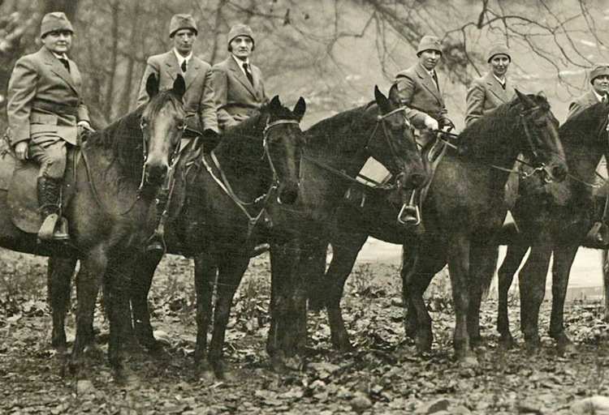
PHI 305 – Health Care ethics
- Archives used to inform student’s understanding of medical ethics
- E.G. Searle & Co. birth control trials in Appalachia
- Pre-med and nursing students
- Respect and care – learning empathy

Slide 6
ENG 506 – Poetry/Creative writing
- Archives as inspiration for creative projects
- Individualized research and a new approach for students
- Archives as content to explore themes and emotions
- Value of local, family, and historical ties

Slide 7
Hon 140 – Knowledge & Society
- Archives as a tool to understand knowledge creation and dissemination
- Focus on critical thinking, bias, and a modern approach
- Making local connections for students/campus resources
- The “wow” factor

Slide 8
Outcomes & goals
- Start with the skill or idea you want to teach, rather than the materials.
- Promote empathy, critical thinking, and communication.
- Allow students to explore and navigate new terrain.
- See archivists and librarians as partners in teaching and learning.

Slide 9
Learn more:
Matthew Strandmark
mstrandmark@uky.edu

